Slide 1
Recent Quality and Testing Events

Slide 2
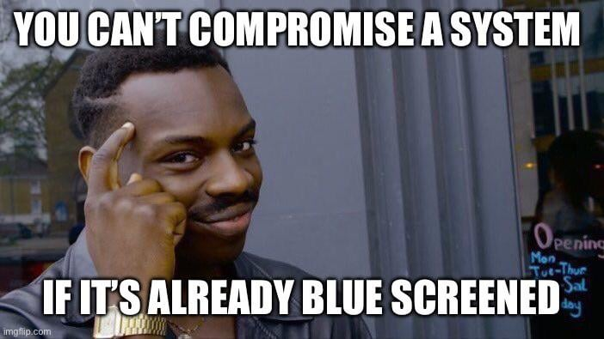
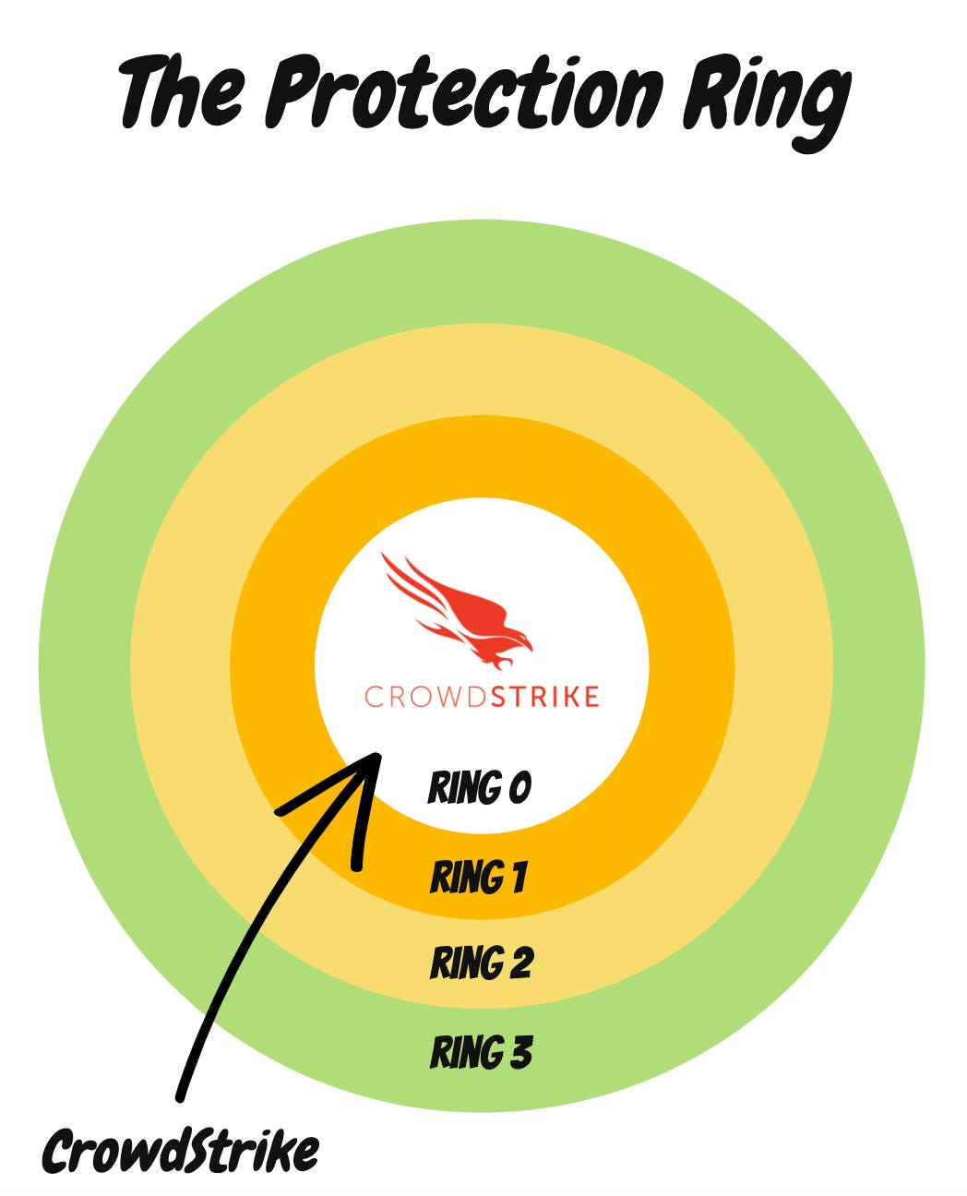
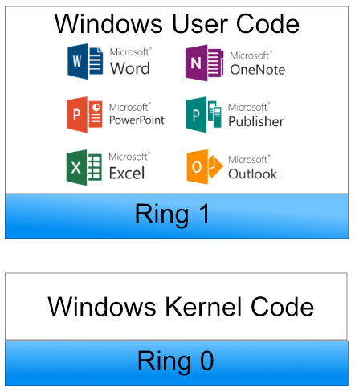
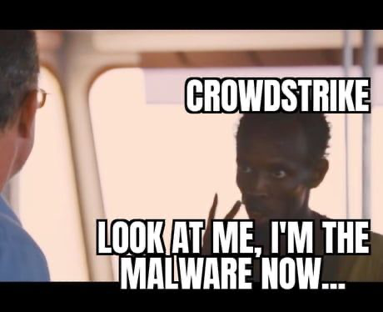
Crowdstrike Outage
https://www.slideegg.com/microsoft-crowdstrike-bsod-presentation

Slide 3
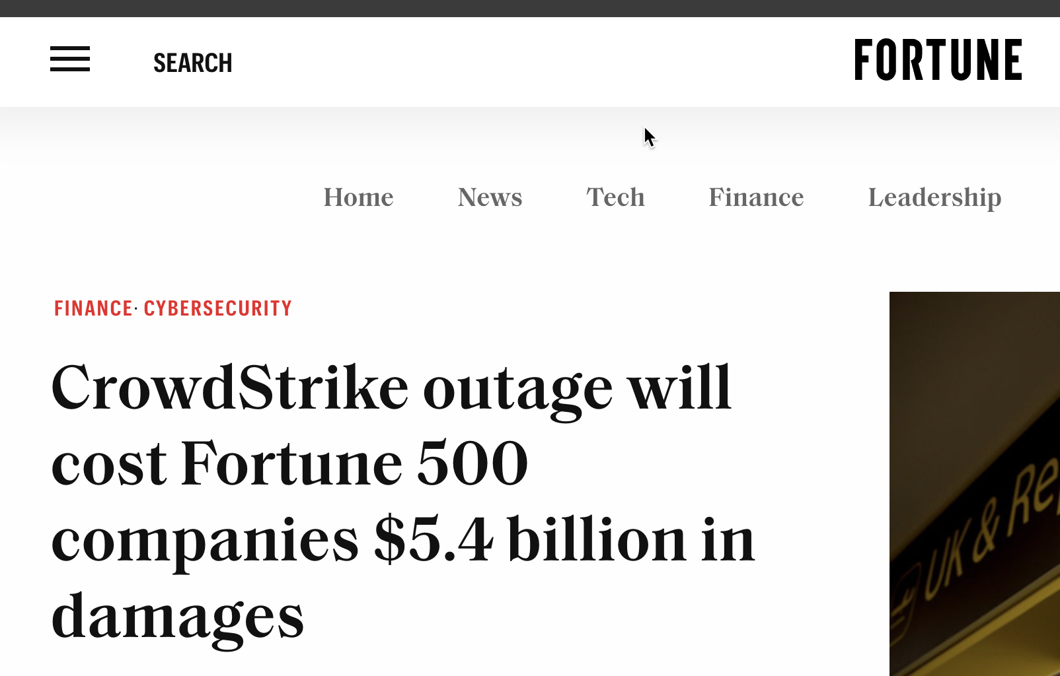
Crowdstrike Outage
What is Microsoft’s responsibility in this? https://www.computerweekly.com/news/366598838/Why-is-CrowdStrike-allowed-to-run-in-the-Windows-kernel#:~:text=The%20reason%2C%20according%20to%20Microsoft,an%20equal%20footing%20as%20other
https://fortune.com/2024/08/03/crowdstrike-outage-fortune-500-companies-5-4-billion-damages-uninsured-losses/

Slide 4
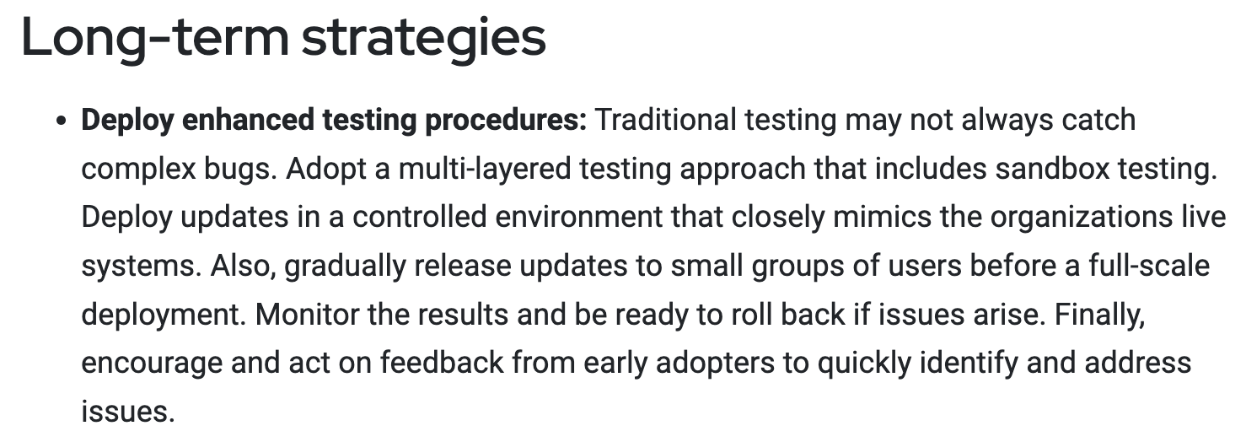
Crowdstrike Outage
https://www.scmagazine.com/perspective/heres-seven-tips-that-offer-short-term-and-long-term-fixes-following-the-crowdstrike-outage

Slide 5
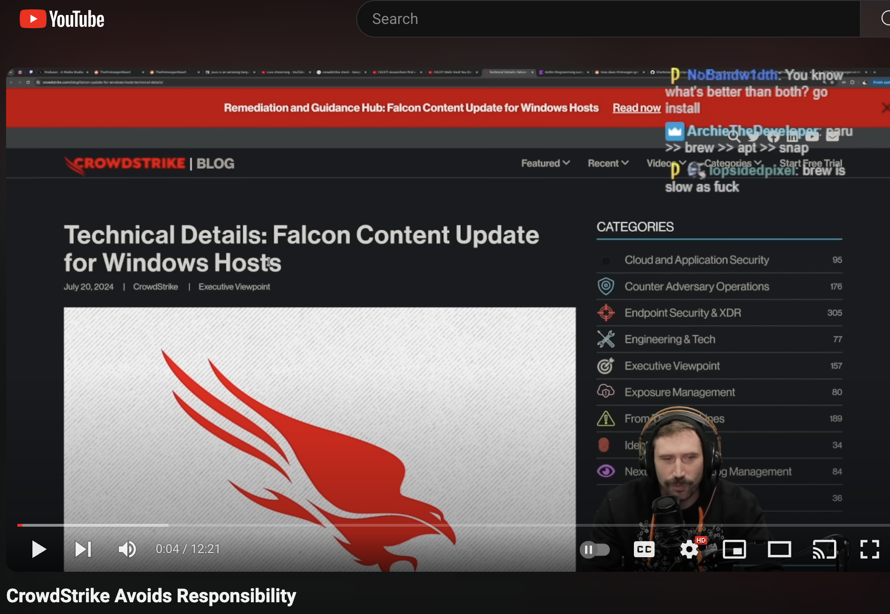
Crowdstrike Outage
https://www.youtube.com/watch?v=WoWXjKAbGZU

Slide 6
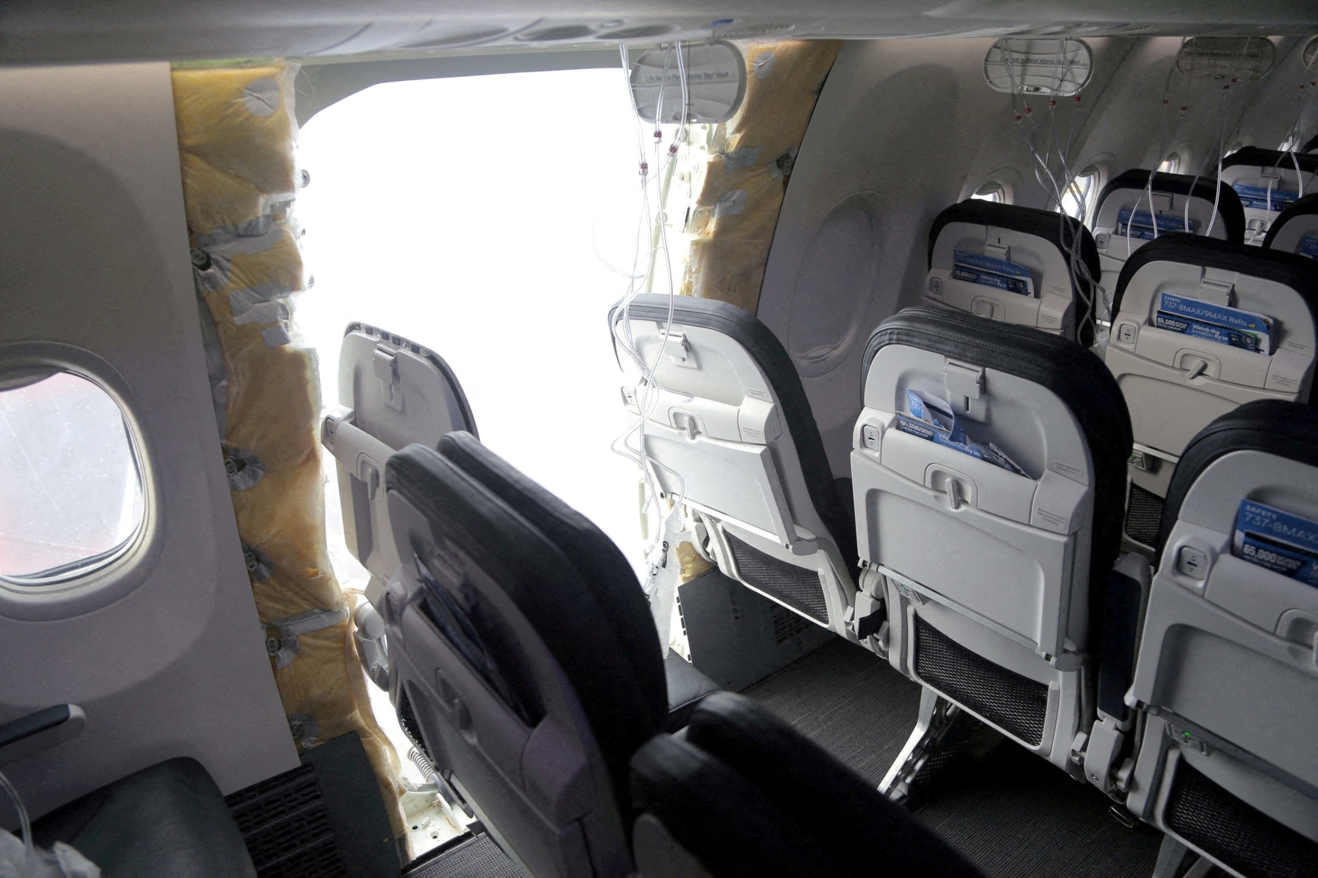
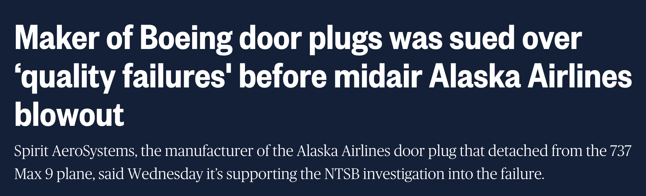
Boeing 737 Door Plug
https://www.cnn.com/2024/06/27/business/boeing-cause-alaska-air-door-plug/index.html
https://www.nbcnews.com/news/us-news/maker-boeing-door-plugs-sued-quality-failures-midair-alaska-airlines-b-rcna133291

Slide 7
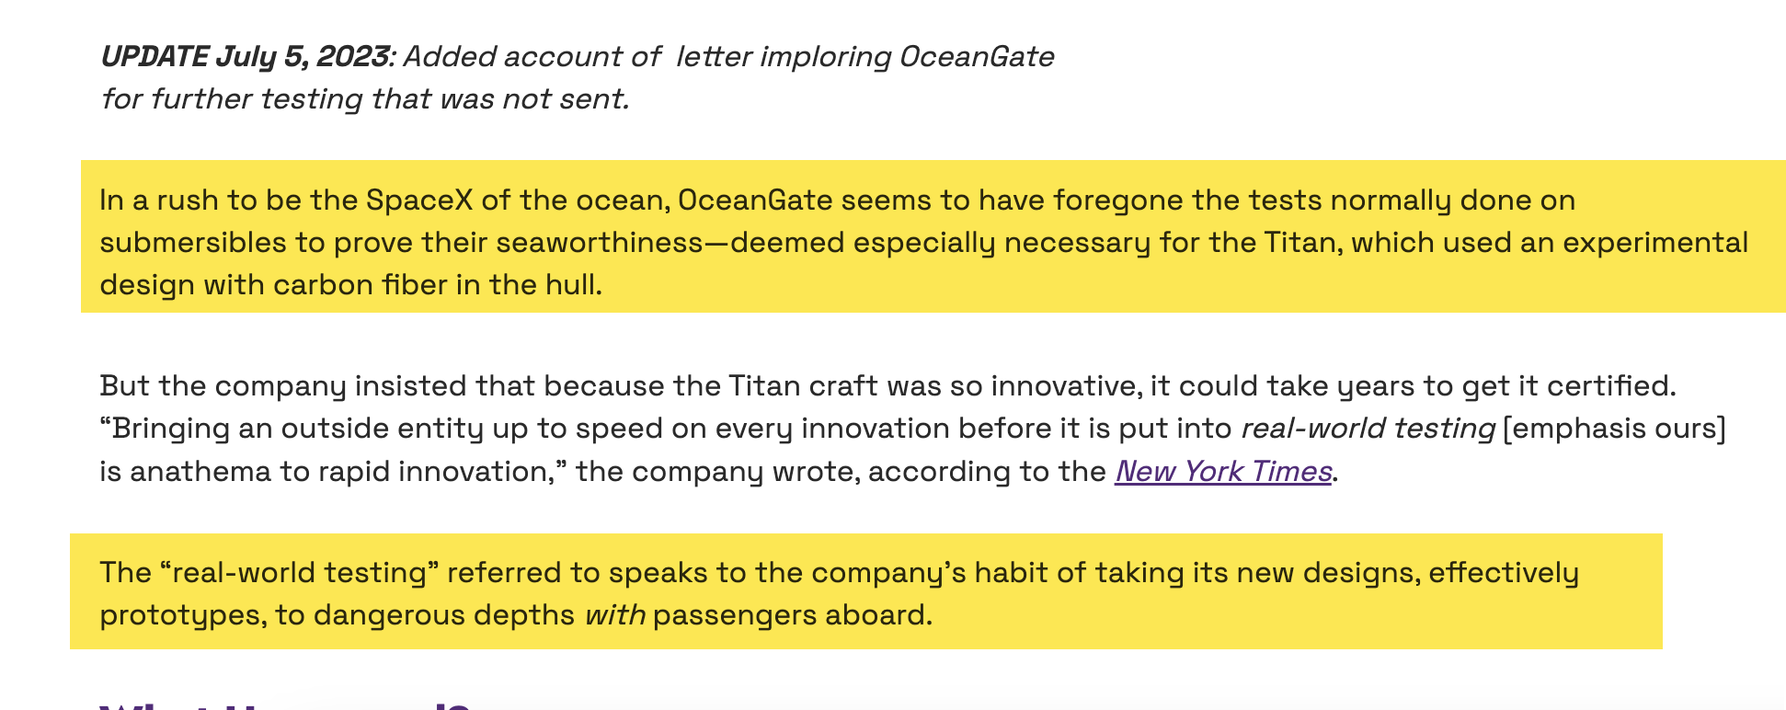

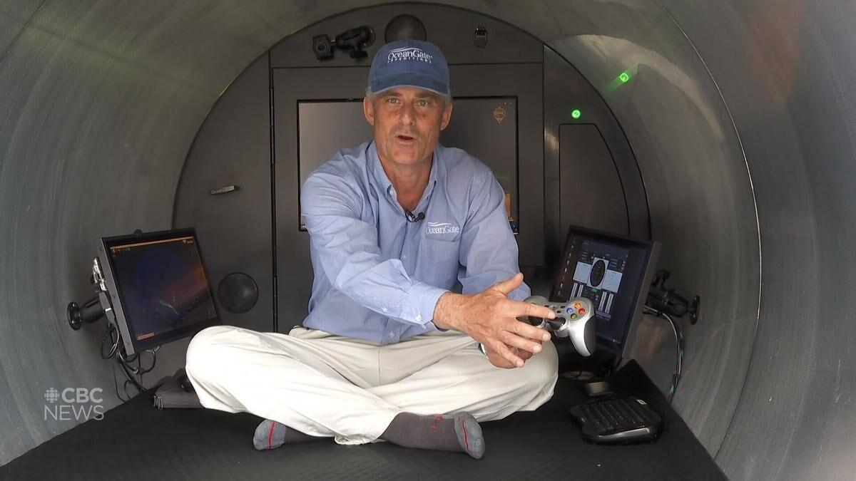
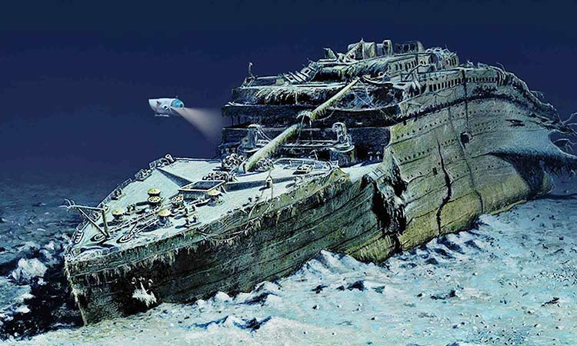
Titan Submersible Implosion
https://www.engineering.com/the-titan-submersible-a-little-testing-wouldnt-have-killed-them/

